Slide 1
Online Banking
System
Group Number : 2
Mentor : Mrs. Shital Patil
Notes:
Add instructor notes here.

Slide 2
CONTENTS:
Project Understanding
Approach used
Project Execution
Modules
Learning
Best Practices
Opportunity for improvement
Demo and Code Walkthrough
Q&A
Notes:
Add instructor notes here.

Slide 3
Project Understanding
Objective: Development of an Online Banking System
Abstract: The project, Online Banking System, allows the user to register for online banking services. The users can make monetary transactions, add payee to make transactions to, display loan details against themselves and also request for a cheque book.
Notes:
Add the notes here.
Add instructor notes here.

Slide 4
Project Understanding (Continued)
This project is designed for use by an existing customer of a bank.
Using the Online Banking feature, a customer can do the following tasks:
Register for Online Banking Service.
The services that a user is entitled to are as following:
Adding Payee to make transactions.
Making Transactions
Applying for new Cheque Book.
Displaying Loan details.
Notes:
Add the notes here.
Add instructor notes here.

Slide 5
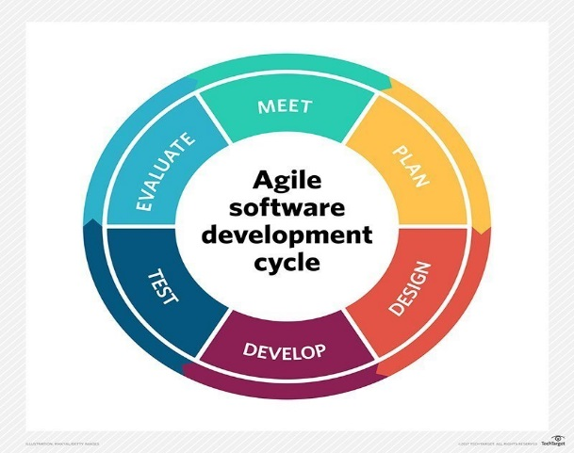
Approach Used :
We have used Agile Development Model for the completion of this project.
Agile Development Model works on the basis of modern development approach which believes that every project and every project’s needs are different.
Agile Development Model breaks the software into small incremental builds.
These builds are provided in iterations.
Notes:
Add the notes here.
Add instructor notes here.

Slide 6
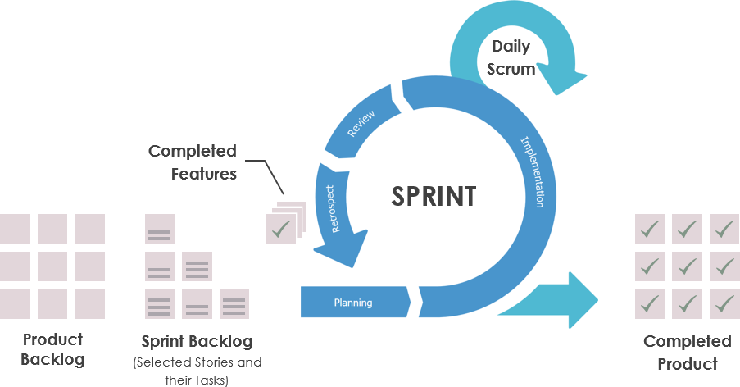
Approach Used:
These iterations are known are Sprints.
Each sprint lasts from about one to three weeks.
Every iteration involves cross-functional teams working simultaneously on various areas like planning, requirement analysis, design, coding, unit testing and acceptance testing.
At the end of the sprint/iteration a working product is displayed to the customers and important stakeholders.
Notes:
Add the notes here.
Add instructor notes here.

Slide 7
Project Execution
This explains the technology on which the project is based and the layered architecture.
Database Layer (It includes the queries for table creation and stored procedures.)
MS SQL Server
Data Model
Database Schema
Business Layer (It includes the code that is used to connect to the database layer.)
Web API using ADO.NET
C# 7.0
Presentation Layer (It includes the code that connects to the business layer and creates the User Interface.)
ASP.NET MVC
Notes:
Add the notes here.
Add instructor notes here.

Slide 8

Modules
Notes:
Add the notes here.
Add instructor notes here.

Slide 9
Modules
The project comprises of 5 basic services or modules :
The first service is the register feature using which the user registers for Online Banking.
The user has to enter his/her phone number which checks whether he/she has an account in the bank and proceeds if its affirmative.
The password that the user enters must be 6 characters long.
Notes:
Add the notes here.
Add instructor notes here.

Slide 10
Modules
The second service is the add Payee feature using which the user to add Payees to make transactions to.
The payee to be added must also have an account in the same bank and is referenced with the phone number provided.
The third service is the transaction feature which allows the user to make monetary transactions to the added Payee.
The amount that can be transferred has an upper limit and cannot be more than the account balance of the user.
The amount must also be an integer.
Notes:
Add the notes here.
Add instructor notes here.

Slide 11
Modules
The fourth service is the request cheque book feature which allows the user to request for a new cheque book online.
The user can enter the number of pages he/she wants in the cheque book and it should be an integer.
The fifth service is the loan details which allows the user to display the loan taken against them .
The user can input the principal and select the loan type and the total amount to be paid will be displayed .
Notes:
Add the notes here.
Add instructor notes here.

Slide 12

Learning
Notes:
Add the notes here.
Add instructor notes here.

Slide 13
Learning
The main focus was on individuals and interactions.
Setting very short term goals and working interactively towards them.
During the course of this project we understood how to implement the concept of agile development model and scrum methodology.
The use of SQL to create a database.
Using ADO.NET and Web API to create a business layer.
Using ASP.NET MVC to create a presentation layer which serves as the user interface.
The overall implementation of a layered architecture.
Notes:
Add the notes here.
Add instructor notes here.

Slide 14

Notes:
Add the notes here.
Add instructor notes here.

Slide 15
Best Practices
Discussion about the work done and the work to be done on a daily basis.
Dividing the work equally among the team members.
Step-by-step debugging of code.
Sharing the codebase among all the team members.
Simple Design
Continuous refactoring and test-driven development.
Notes:
Add the notes here.
Add instructor notes here.

Slide 16

Opportunity for improvement
Notes:
Add the notes here.
Add instructor notes here.

Slide 17
Opportunity for improvement
The following are the points which could be factored into the project to improve its robustness-
Session Management
OTP generation/E-Mail Verification
Forgot Password Feature
Notes:
Add the notes here.
Add instructor notes here.

Slide 18
Q & A
Notes:
Add the notes here.
Add instructor notes here.

Slide 19
Thank You
Notes:
Add the notes here.
Add instructor notes here.

